Slide 1
Financial Update and Statement
Season 2022 - 2023
Bancroft Players Amateur Dramatic Society
Big Spirit Youth Theatre
Ensemble
Junior Bancroft Players
Mark Weatherbed
Treasurer
Thursday July 13th 2023

Slide 2
Summary of the Year
As a Society we came through COVID and closures pretty much unscathed, despite some challenging cost increases in energy and utilities beyond our original forecasts, we have continued to build reserves and spend where needed to support the organisation
We have tried to maintain a steady growth in certain areas. Bar sales have done extremely well and the reintroduction of tea and coffee has clearly paid off. We have played with bar pricing and ticket pricing to see the impact of change and are confident to move then a little now for next year for certain shows
As with all buildings, we needed to continue to maintain ourselves as a safe place to visit and ongoing maintenance/replacement of items aged or otherwise. As Treasurer, I continue to drive policy for large spend approvals and most (but not all) large expenditure was pre-approved as part of an agreed process.
Our largest outgoings remain Theatre Overheads, Utilities and Insurance, but the single largest investment was to refurbish our foyer and bar area. Having entered this season very cash positive, our 40th year in the QMT, we earmarked considerable spend to satisfy that and what we wanted to do and still do this year

Slide 3
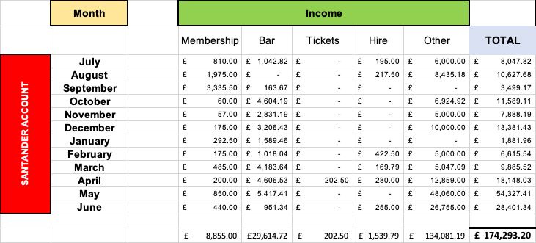
Finances 2022 – 2023 – SANTANDER BANK
Notes:
Simplified Constitution - CIO’s have certain statutory powers that would otherwise have be detailed more fully to the Charity Commission
Greater Flexibility – Despite certain regulatory requirements stipulating a CIO constitution, there is more flexibility to establish our own governance procedures
Less punitive – The regulations governing CIOs do not penalise the CIO for the misconduct of the Trustees and they set out clear duties for the Trustees and Members
Personal Risk to members – under the current incorporated charity we are at a personal risk as a member

Slide 4
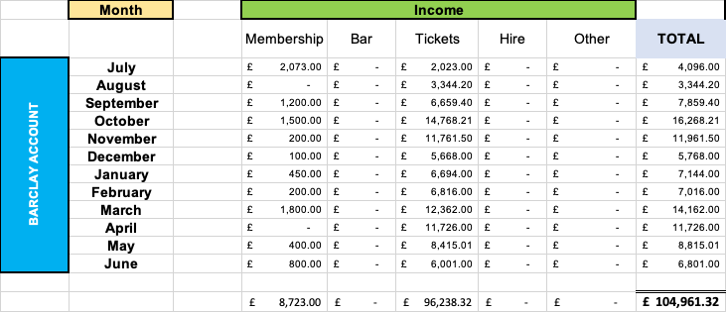
Finances 2022 – 2023 BARCLAYS BANK
Notes:
Simplified Constitution - CIO’s have certain statutory powers that would otherwise have be detailed more fully to the Charity Commission
Greater Flexibility – Despite certain regulatory requirements stipulating a CIO constitution, there is more flexibility to establish our own governance procedures
Less punitive – The regulations governing CIOs do not penalise the CIO for the misconduct of the Trustees and they set out clear duties for the Trustees and Members
Personal Risk to members – under the current incorporated charity we are at a personal risk as a member

Slide 5
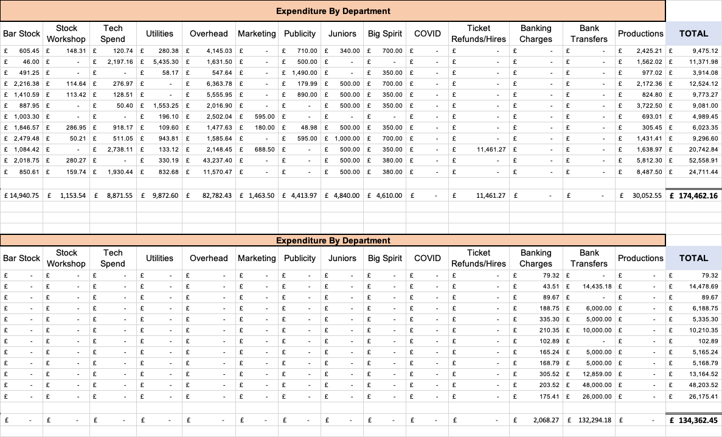
Finances 2022 – 2023
Santander Bank
Barclays Bank
Notes:
Simplified Constitution - CIO’s have certain statutory powers that would otherwise have be detailed more fully to the Charity Commission
Greater Flexibility – Despite certain regulatory requirements stipulating a CIO constitution, there is more flexibility to establish our own governance procedures
Less punitive – The regulations governing CIOs do not penalise the CIO for the misconduct of the Trustees and they set out clear duties for the Trustees and Members
Personal Risk to members – under the current incorporated charity we are at a personal risk as a member

Slide 6
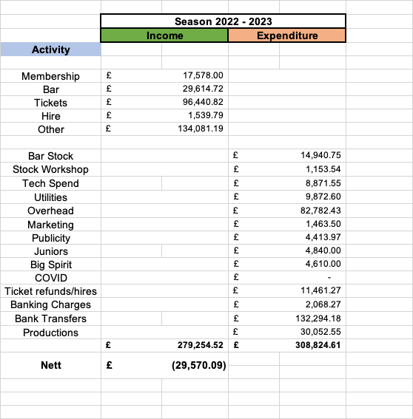
Finances 2022 - 2023
Notes:
Charity Trustee’s and Member’s, are becoming more aware of the financial risks associated with running charities, so there is a growing trend to move more towards the use of limited liability companies
There is a constant battle between what regulations which we are governed by, the Charities Act, and those by which are imposed on companies by company law.

Slide 7
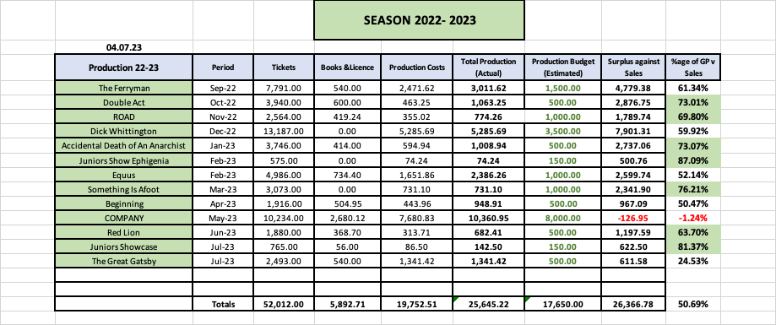
Finances - Productions 2022 - 2023
Notes:
Simplified Constitution - CIO’s have cert
Greater Flexibility – Despite certain regulatory requirements stipulating a CIO constitution, there is more flexibility to establish our own governance procedures
Less punitive – The regulations governing CIOs do not penalise the CIO for the misconduct of the Trustees and they set out clear duties for the Trustees and Members
Personal Risk to members – under the current incorporated charity we are at a personal risk as a member

Slide 8
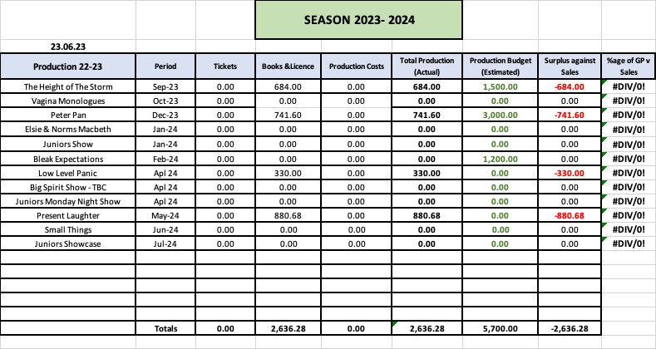
Finances - Productions 2022 - 2023
We continue to invest in the future
Notes:
Simplified Constitution - CIO’s have cert
Greater Flexibility – Despite certain regulatory requirements stipulating a CIO constitution, there is more flexibility to establish our own governance procedures
Less punitive – The regulations governing CIOs do not penalise the CIO for the misconduct of the Trustees and they set out clear duties for the Trustees and Members
Personal Risk to members – under the current incorporated charity we are at a personal risk as a member

Slide 9
Thank You – Any Questions

